Slide 1
Electronic Configuration of Ions

Slide 2
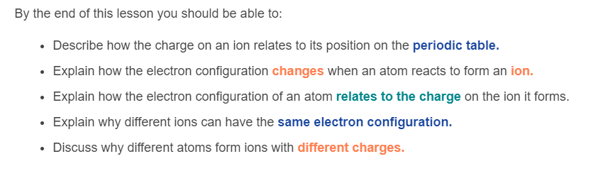

Slide 3
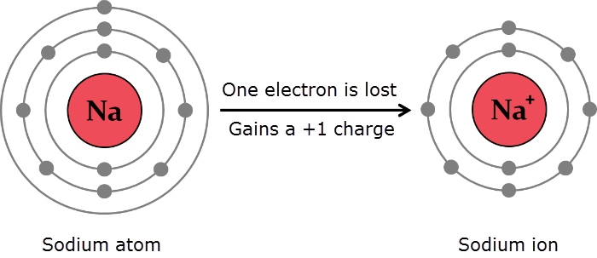
Ions are charged particles that form when an atom or molecule loses or gains electrons.
Atoms are most stable when their outer electron shell is either filled with electrons or empty of electrons. During chemical reactions, atoms will gain or lose electrons in order to achieve a more stable state.

Slide 4
The different electron shells can hold different numbers of electrons.
• | The first electron shell can hold up to 2 electrons.
• | The second electron shell can hold up to 8 electrons.
• | The third electron shell can hold up to 18 electrons.

Slide 5
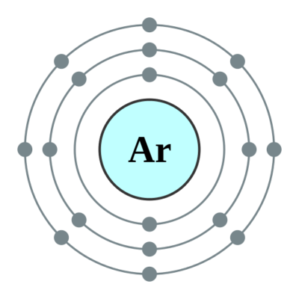
Atoms will gain or lose valence electrons in order to obtain a full valence shell and become stable.
The noble gases in group 18 of the periodic table do not form ions, because they already have full valence shells and are therefore already stable. Gaining or losing electrons would make them less stable!

Slide 6
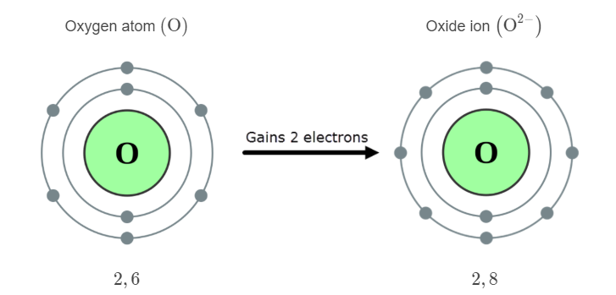
When other atoms gain or lose electrons to fill their valence shells, the ion that forms has the same electron configuration as the noble gas that is nearest to that element.
For example, an oxygen atom has 6 valence electrons in its second shell. The easiest way to obtain a full shell and become stable is to gain 2 electrons (rather than losing 6 electrons). We can draw the electron shell diagrams and write the electron configurations for the atom and ion as shown below:

Slide 7
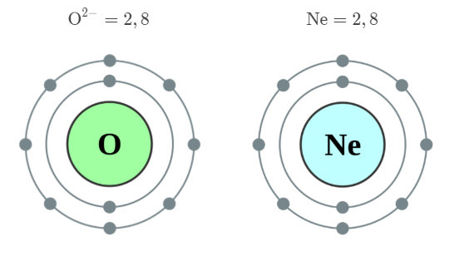
The electron configuration of the oxide ion (O²⁻) is: 2,8. You may notice that this is the same electron configuration as a neon atom (Ne), which is the closest noble gas to oxygen in the periodic table.

Slide 8
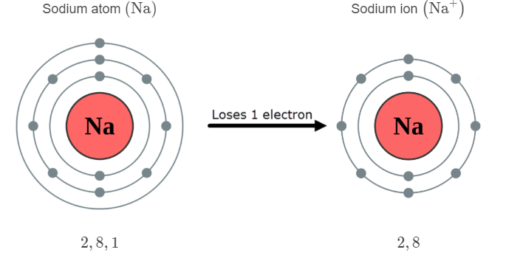
A sodium atom has 1 valence electron in its outer shell. The easiest way to obtain a full shell and become stable is to lose this electron (rather than gaining 7 electrons). We can draw the electron shell diagrams and write the electron configurations for the atom and ion as shown below:

Slide 9
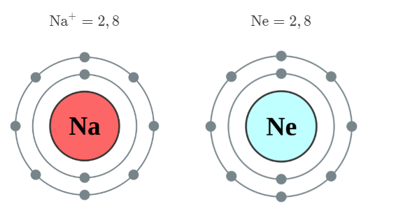
The electron configuration of the sodium ion (Na⁺) is: 2,8. Just like the oxide ion, this has the same electron configuration as a neon atom (Ne), which is the closest noble gas in the periodic table to sodium.

Slide 10
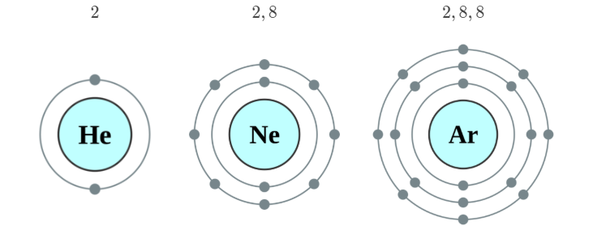
You can see that most ions will have the same electron configuration as the noble gas that is nearest to that element.
The electron configuration of the ions you will come across this year will therefore be one of the following three options. Your job is to figure out which one of these it will be!

Slide 11
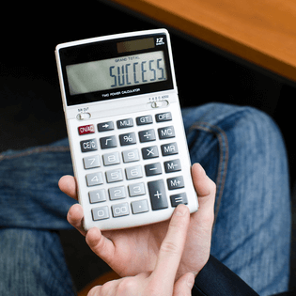
Let's look at the charge on ions in some more detail.
In this section you will learn how to determine the net charge on an ion from the number of protons and electrons it contains, or determine the number of protons and electrons it contains from its charge and atomic number.
You'll also need to be able to explain why different ions have the charges they do.

Slide 12
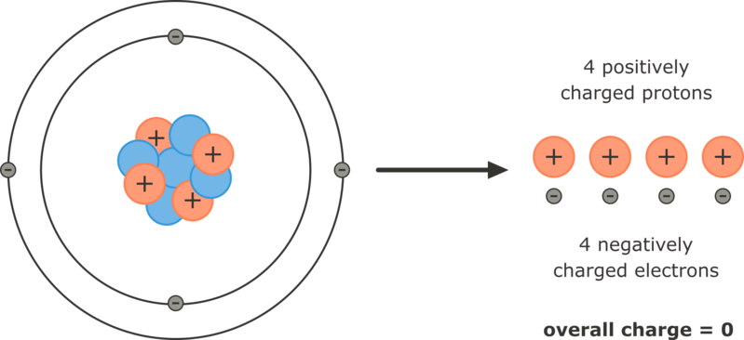
Atoms are electrically neutral particles because they have equal numbers of positively charged protons and negatively charged electrons.
The positive and negative charges cancel out so the atom has no overall charge.

Slide 13
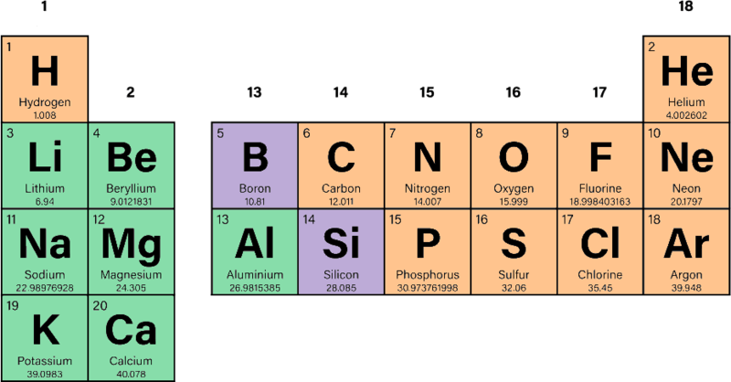
You can figure out what the charge on an ion will be by determining which group of the periodic table it is in and therefore the number of valence electrons it contains.
Remember, elements in groups 1 and 2 have the same number of valence electrons as the group number (1 and 2 valence electrons respectively). Groups 13−18 have the same number of valence electrons as the group number minus 10 (3−8 valence electrons respectively). Helium is the exception in group 18 with just 2 valence electrons.

Slide 14

Group 1 elements (Li,Na,K) have 1 valence electron, so will lose this to become stable. They will form ions with a charge of 1+ because they now have 1 less electron (−) than the number of protons (+) in their nucleus.
Group 2 elements (Be,Mg,Ca) have 2 valence electrons, so will lose these to become stable. They will form ions with a charge of 2+ because they now have 2 fewer electrons (−) than the number of protons (+) in their nucleus.

Slide 15

Group 16 elements (O and S) have 6 valence electrons, so will gain 2 electrons to become stable. They will form ions with a charge of 2- because they now have 2 more electrons (−) than the number of protons (+) in their nucleus.
Group 17 elements (F and Cl) have 7 valence electrons, so will gain 1 electron to become stable. They will form ions with a charge of 1- because they now have 1 more electron (−) than the number of protons (+) in their nucleus.

Slide 16
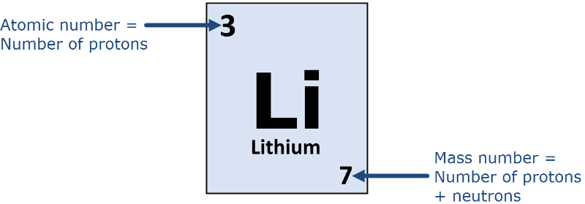
An element's box on the periodic table shows its atomic number. The atomic number tells you the number of protons in an atom. This is equal to the number of electrons for a neutral atom.
When an atom becomes an ion, the atomic number no longer tells you the number of electrons. However, if you know how many electrons the atom will gain or lose to fill its valence shell and become stable, you can calculate the number of electrons it contains and therefore the charge on the ion.

Slide 17
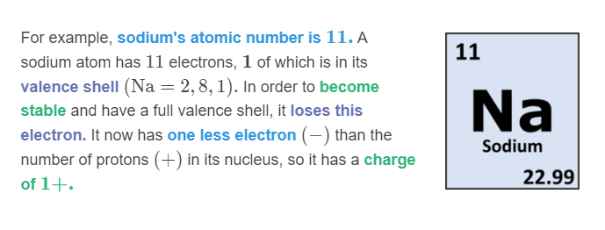
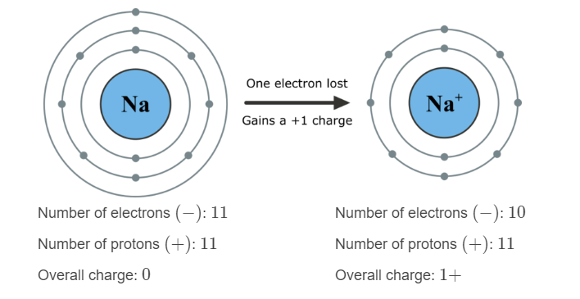

Slide 18
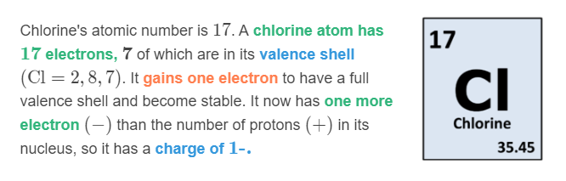
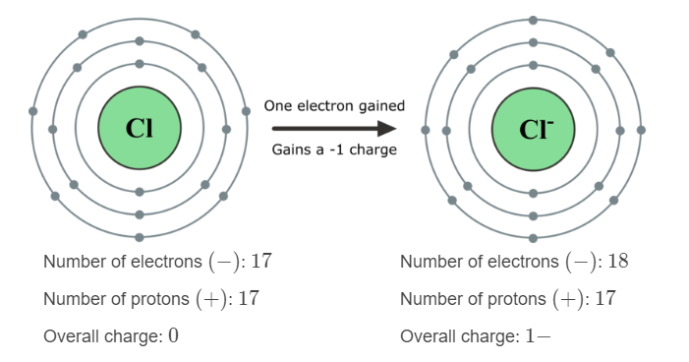

Slide 19
